Slide 1
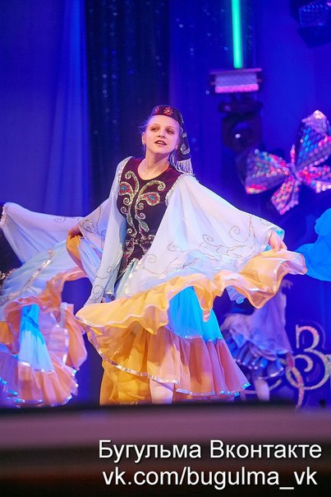
Dancing.
The work is performed by Students 8 "A" class Trisheva Olga
Kostyleva Juliana
Krylova Irina

Slide 2
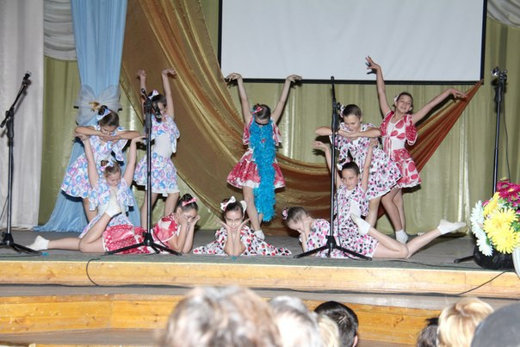
Dance is.
Dance is passion, the feeling, the forgetfulness, the heartbeat and rhythm of your pulse, it's your truth and your lies. The group house culture "the Desire to fly"

Slide 3
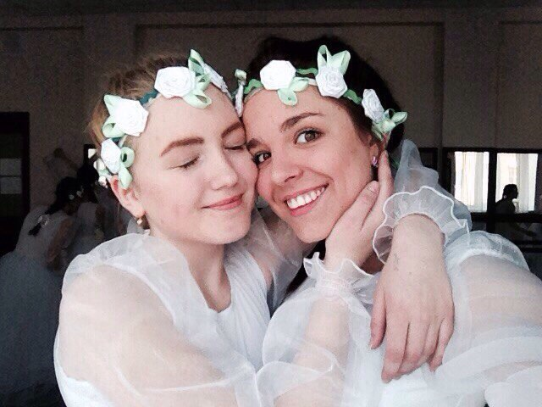
kind of dance:
Free dance
Swing
Modern jazz
Boogie Woogie
Contemp
Lindy
Hop Contact
improvisation
Balboa Butoh
Charleston Electro
Jive Naiyana
House
Rock-n-Roll
Trance
Waacking
Tektonik
Latinos
Strip-Dance
Samba
Go-Go
Rumba

Slide 4
What does dancing mean for this group??
The way of communication and exchange of emotions
Movement is sport and sport is good health
New friends

Slide 5
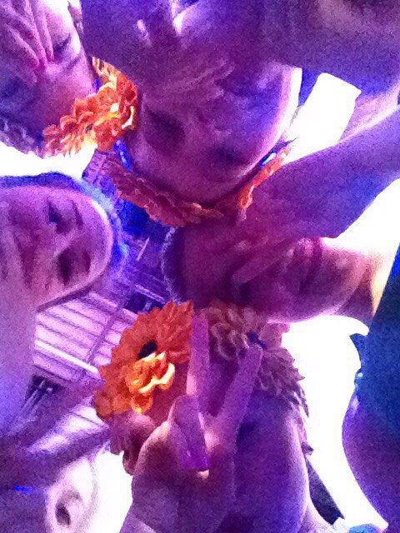
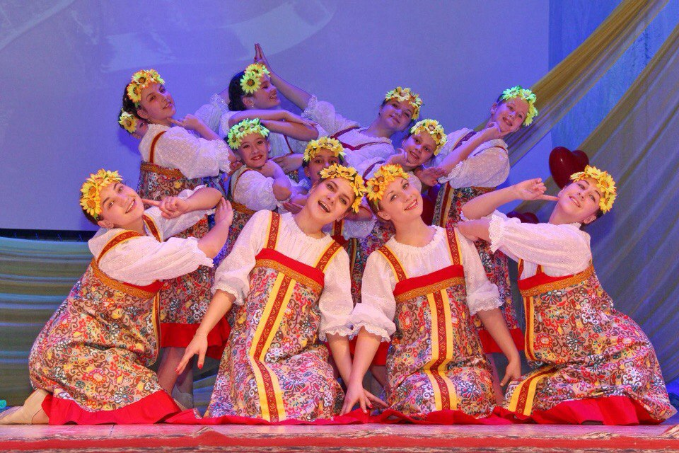
«The desire to fly»

Slide 6
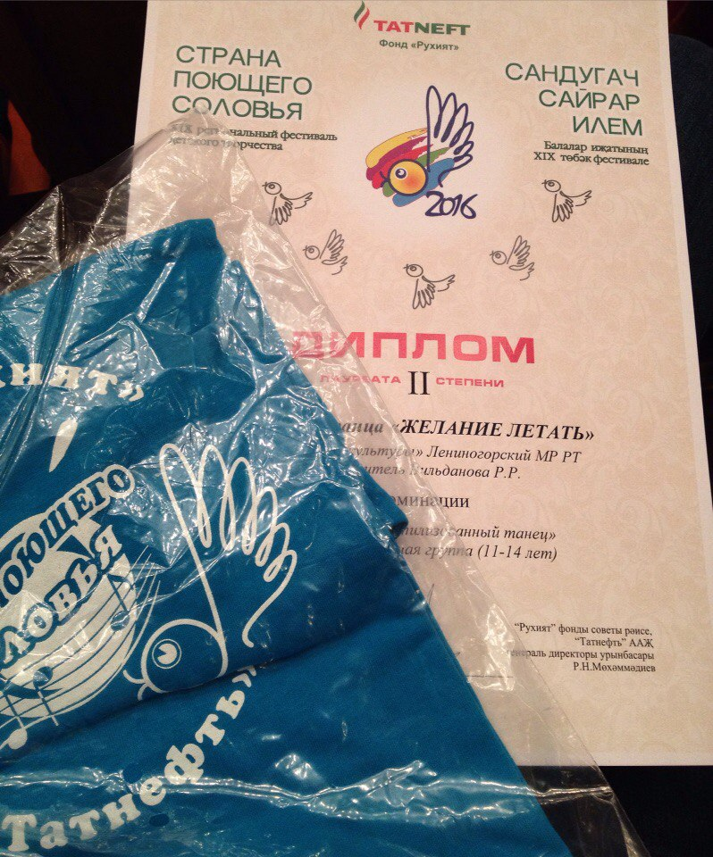
Our first achievement

Slide 7
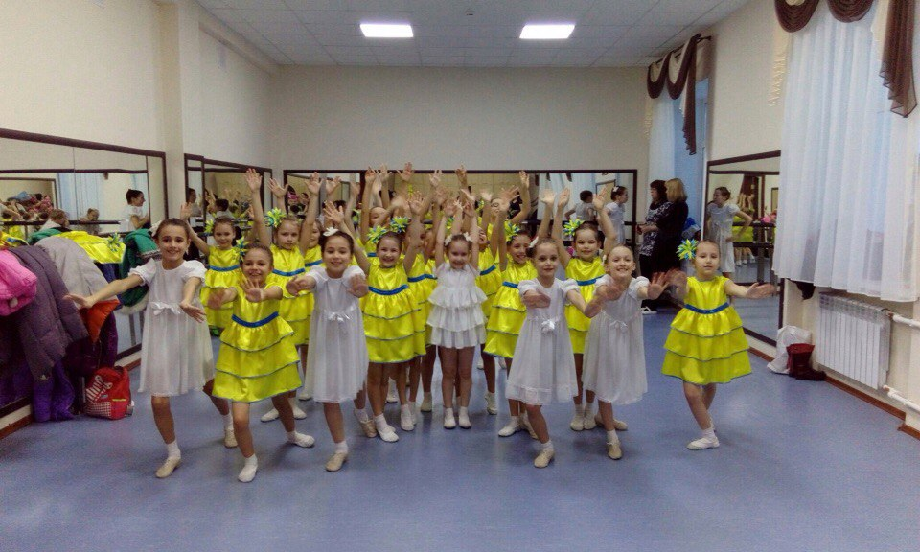
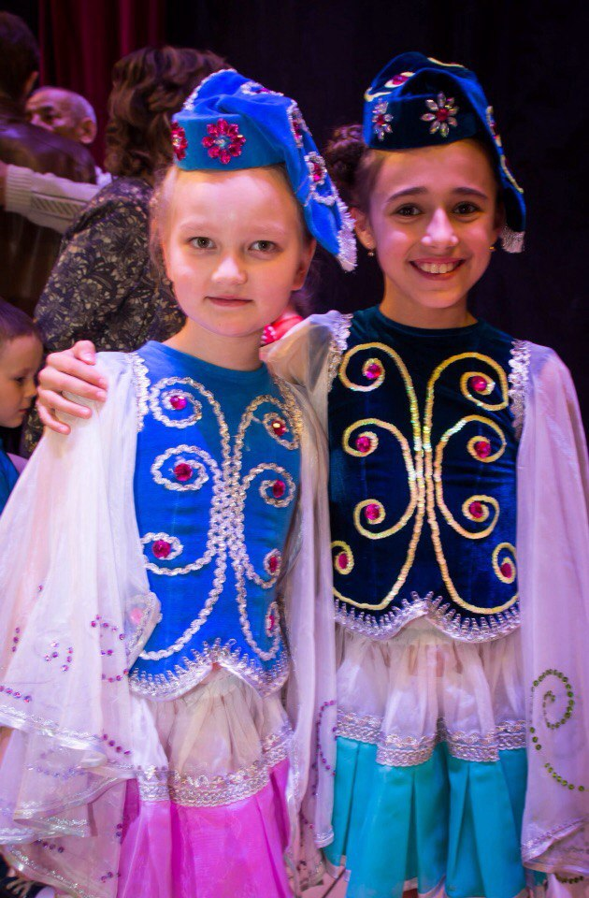
In our team there are little stars

Slide 8
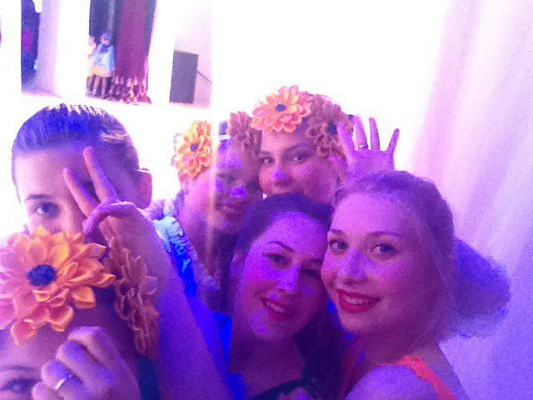
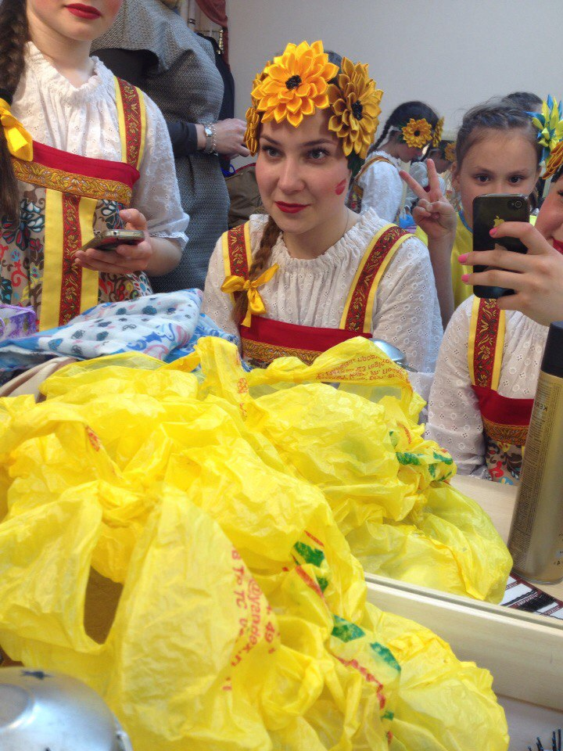
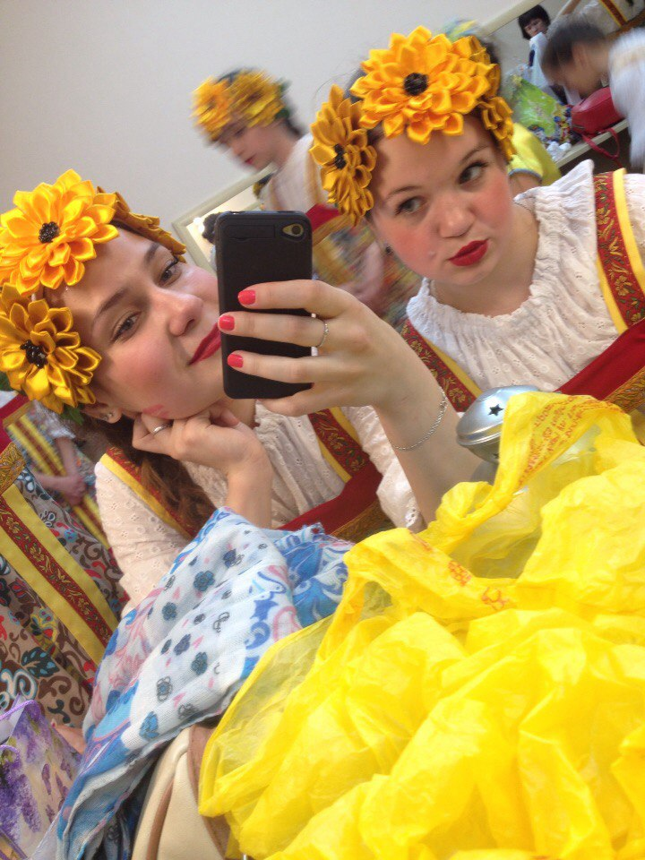
The preparation for the performance

Slide 9
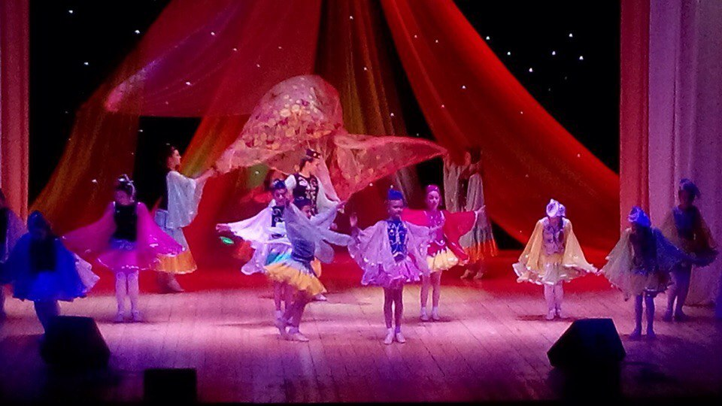
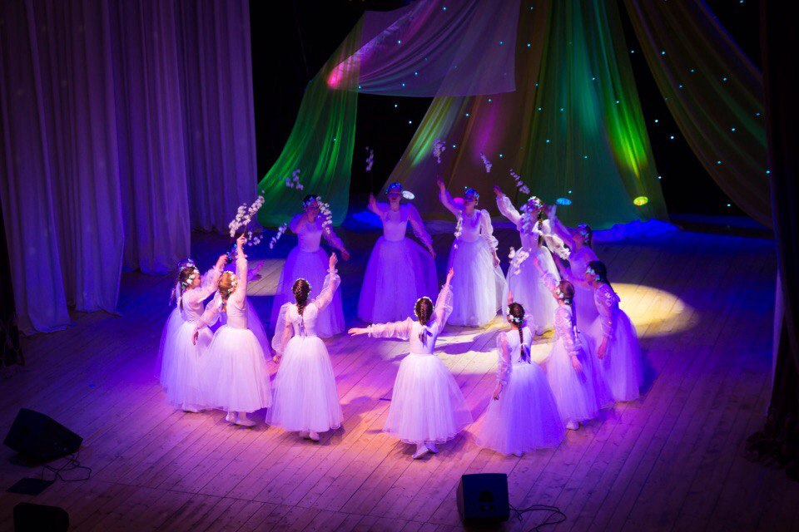
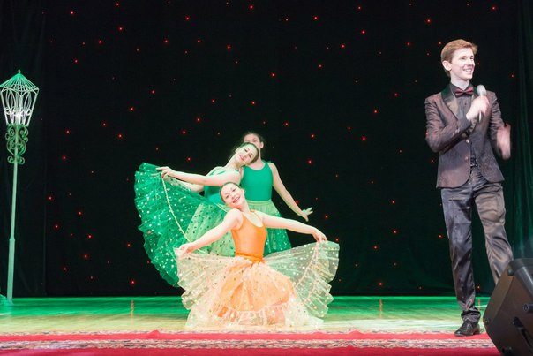
We…

Slide 10
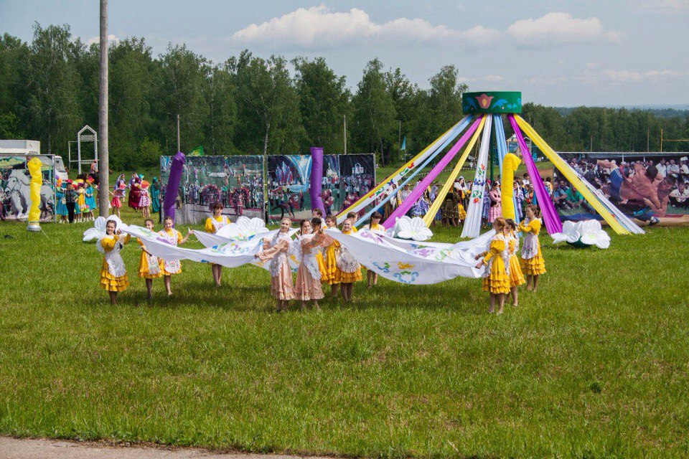
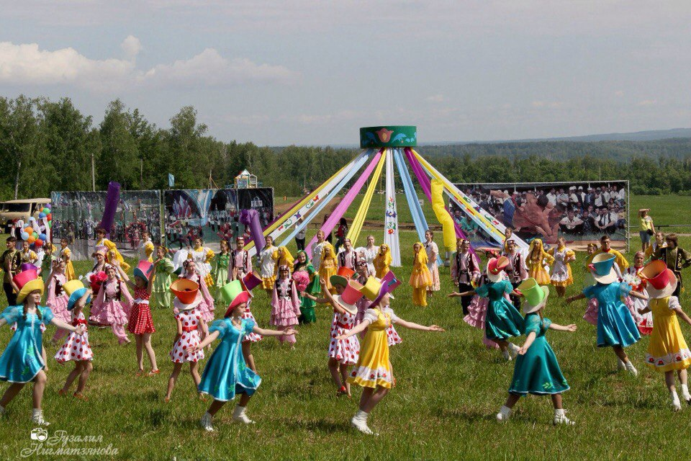
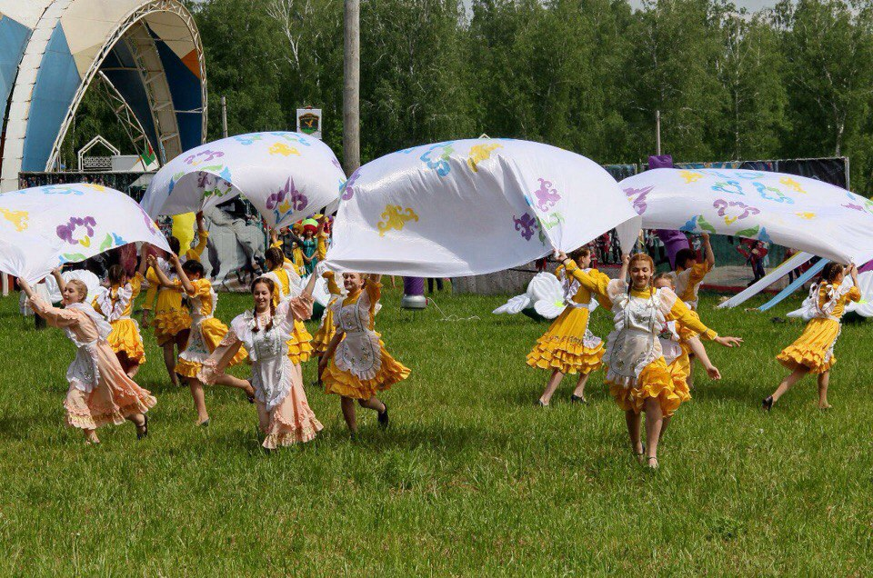
We are in Sabantuy

Slide 11
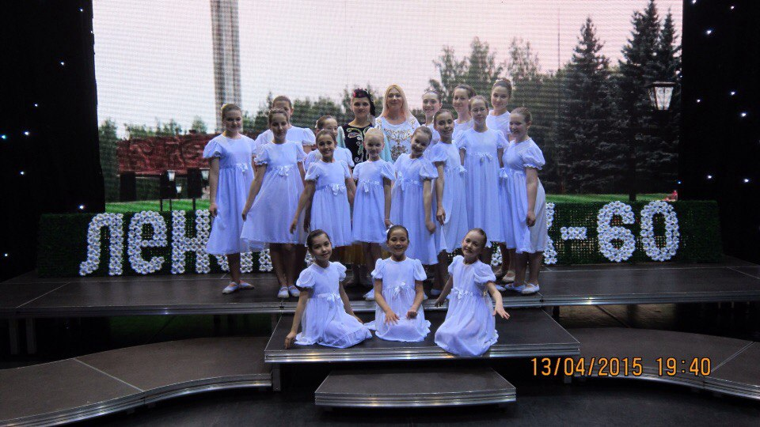

Slide 12
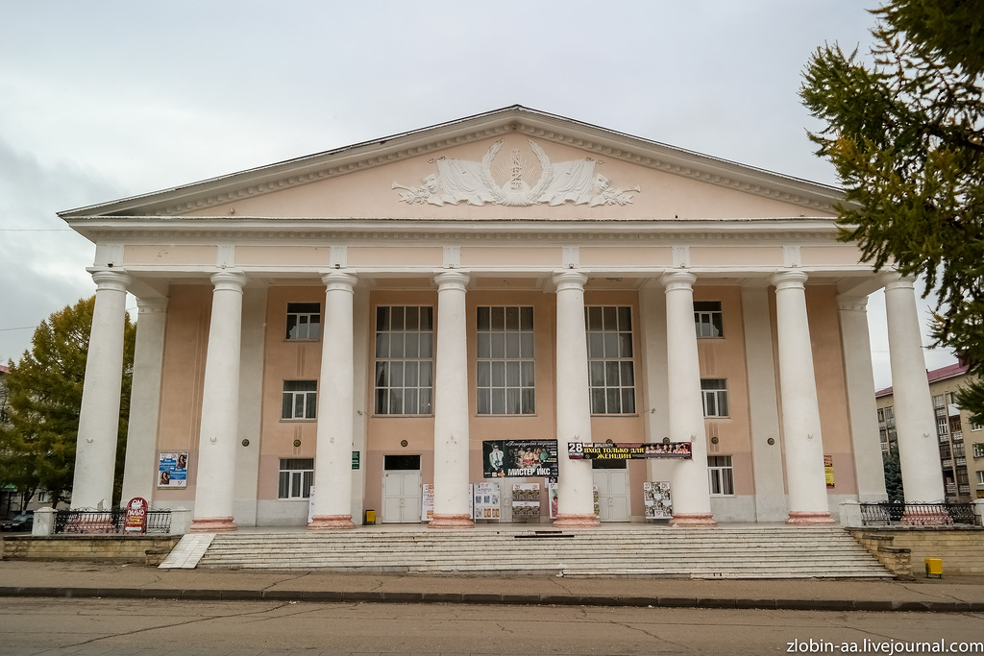
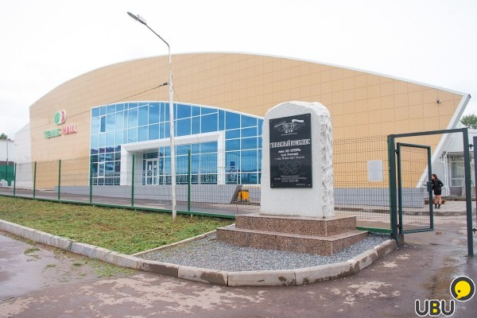
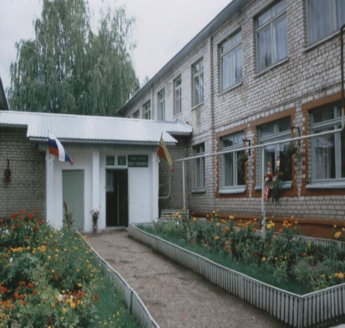
If you like dancing welcome to:
1.The house of culture in Leninogorsk, Tatarstan, Leningrad 28a
2.tennis hall Chakovski
3.the house of children's creativity

