Slide 1

Teenagers hobbies
Kiseleva Sofiya, Efremova Aleksandra, Yanbatirova Il`zida 8B
Leninogorsk, 2016

Slide 2
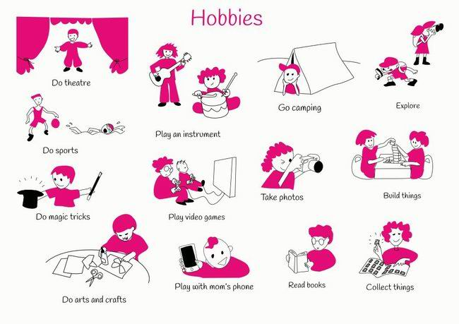
There are many types of hobbies

Slide 3

There are several photos and descriptions of handmade works, which are made by girls of fourteen.
The works are different. They are quelling, embroidery and modeling.

Slide 4
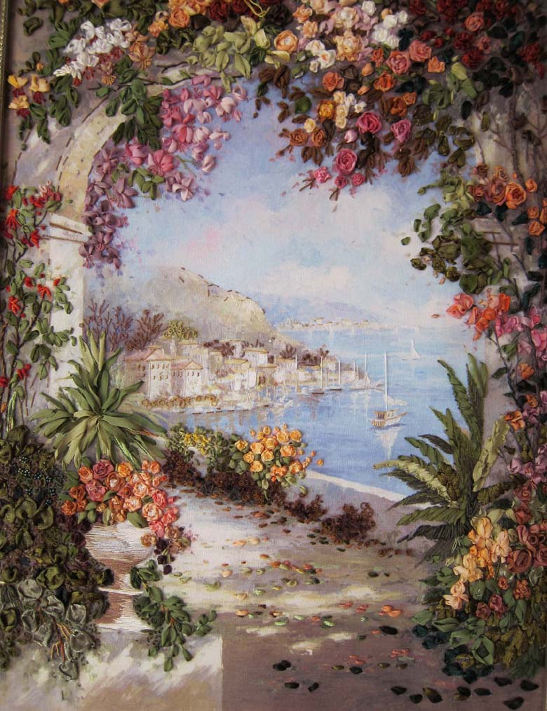
Handiwork
Handiwork is the work performed by hand, the product of a person's efforts and actions. It`s one of the oldest types of art. In the whole world people consider
the best present is a present made by hands.

Slide 5
Embroidery
Quelling
Modeling
Handiwork
Decoupage
Scrapbooking

Slide 6
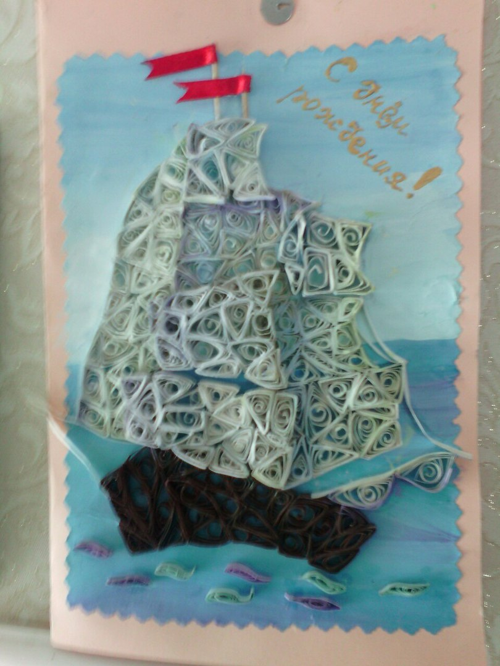
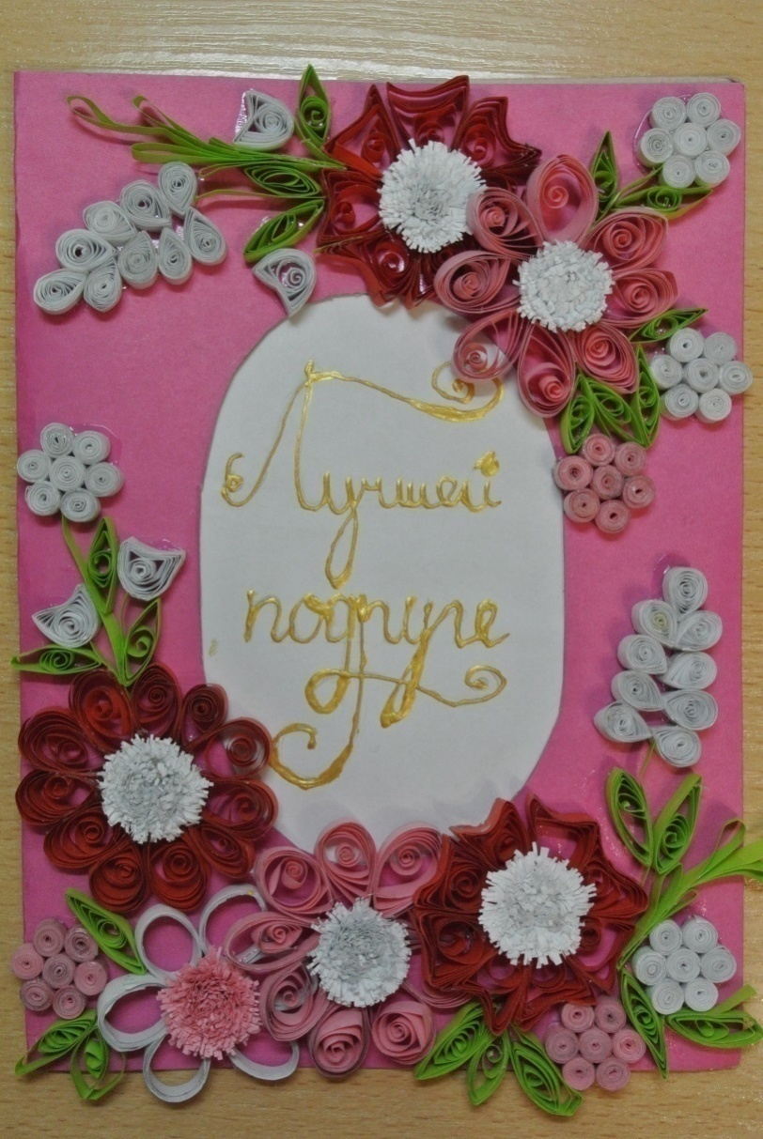
There are works made by Yanbatirova Il`zida. These are birthday cards.

Slide 7
This card is made by quelling. Quilling or paper filigree is an art form that involves the use of strips of paper that are rolled, shaped, and glued together to create decorative designs. Quilling starts with rolling a strip of paper into a coil and then pinching the coil into shapes that can be glued together.
Quelling

Slide 8
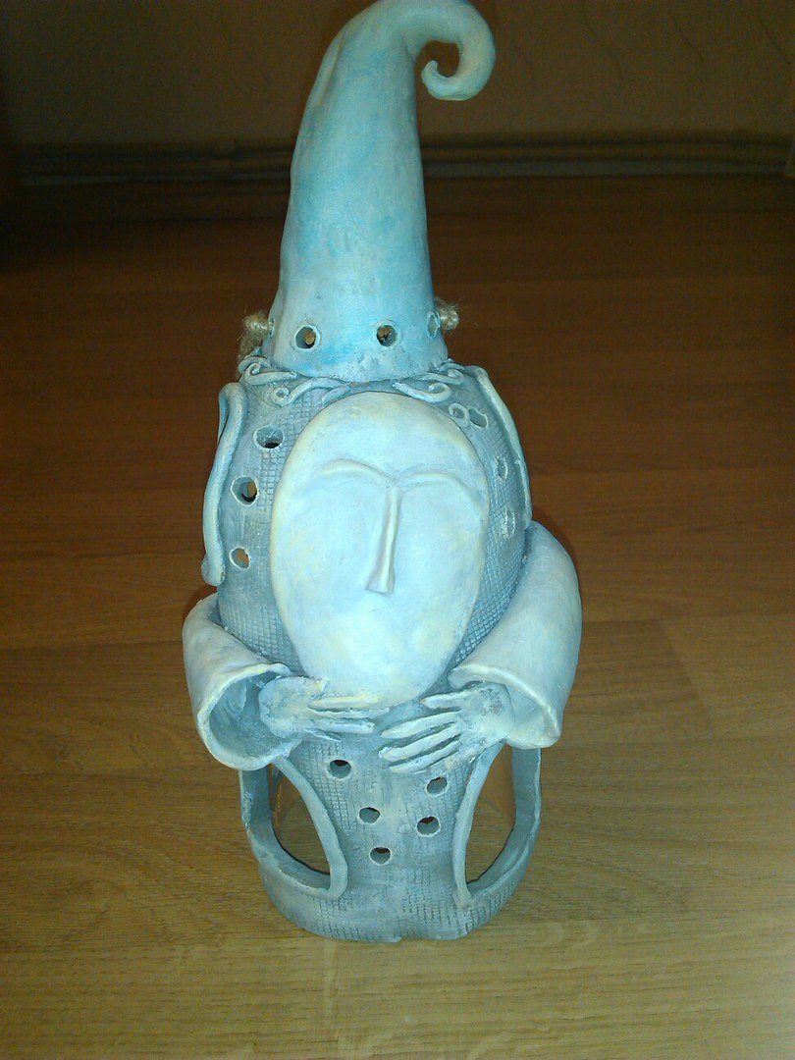
Modeling
«East or West, home is best»- the English proverbs says. People always tried to decorate their houses. You may decorate your home by modeling.
Modeling is making art things from clay and plasticine.
Modeling began with the development of humanity People always like clay.

Slide 9
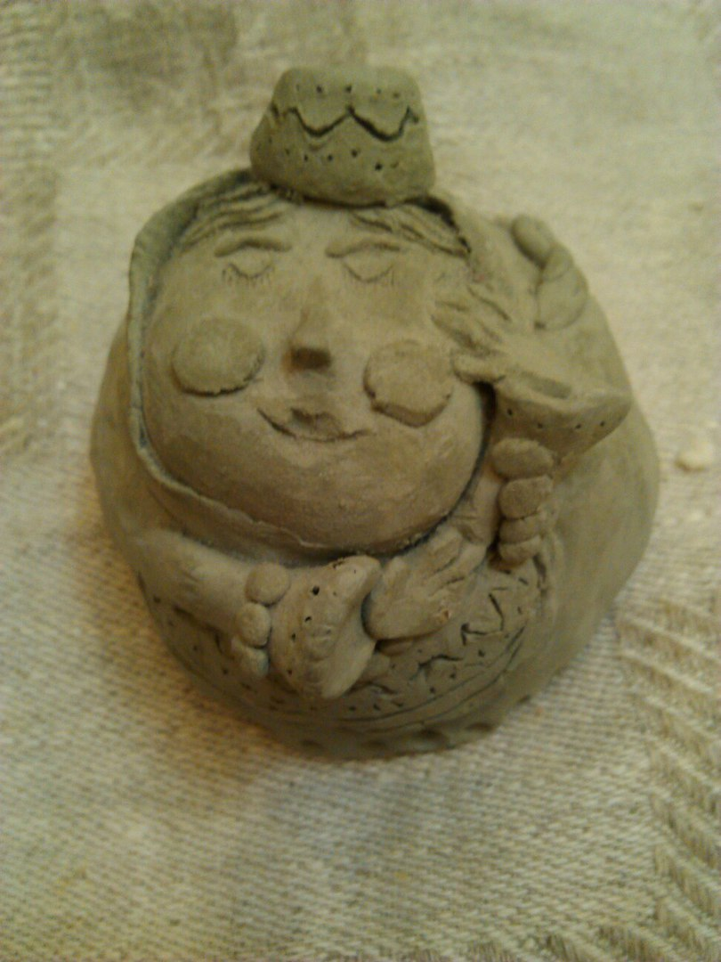
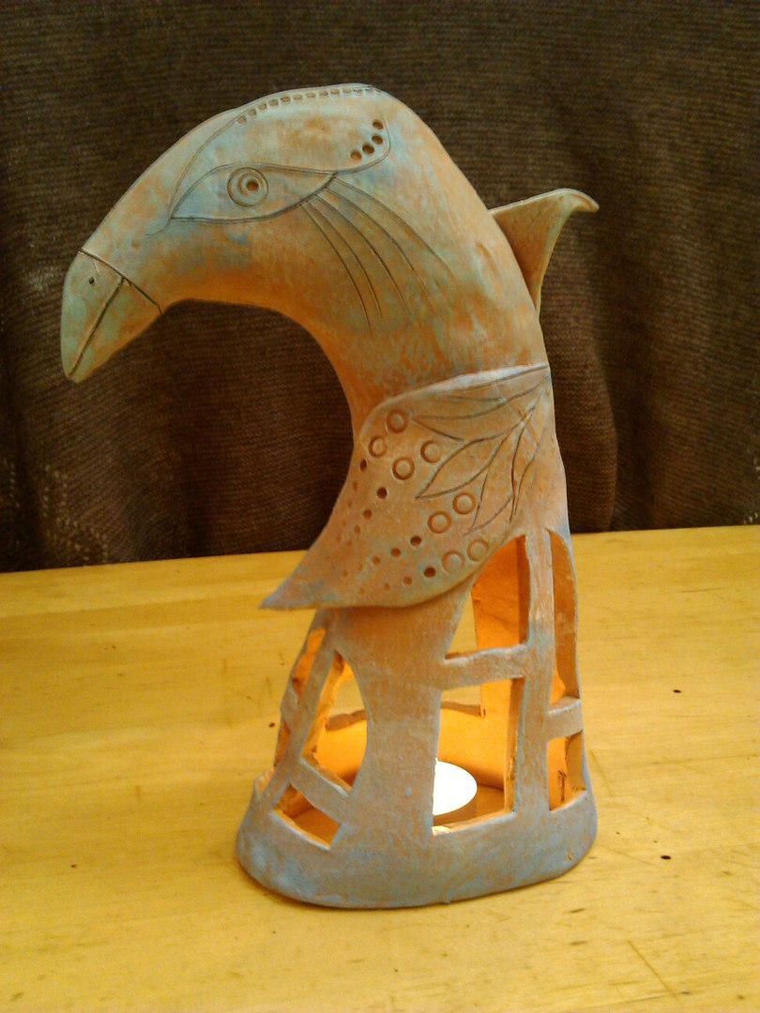
There are several decorative works made by Kiseleva Sofiya
A figure
A candlasticke

Slide 10
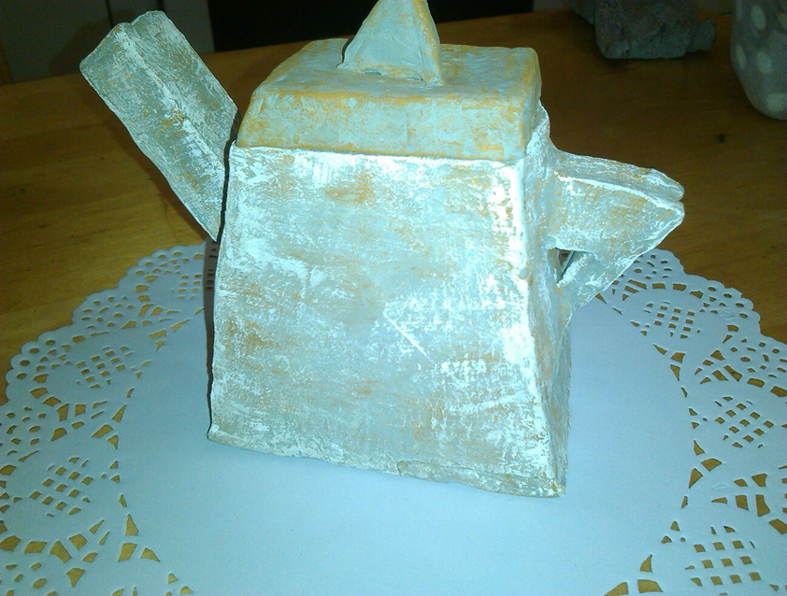
A candlasticke
A teapot

Slide 11
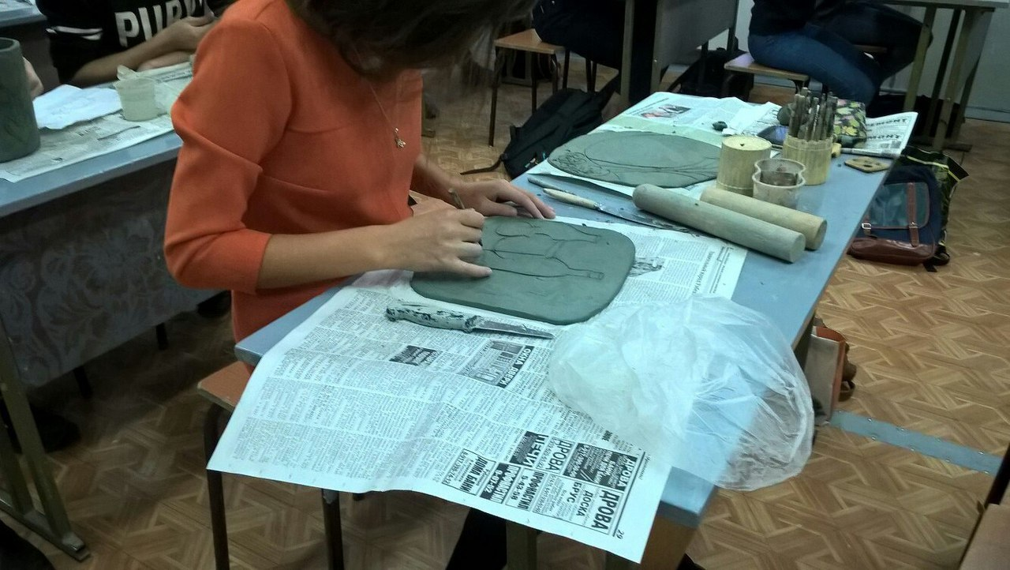
We do handiwork at the art school.
You can go to the art school too.

Slide 12
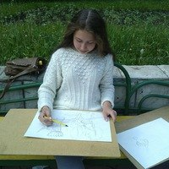
Doing handiwork is a wonderful hobby!

